Slide 1




UNIFIED HEALTHCARE RECORDS & APPOINTMENT SYSTEM
A SECURE, CENTRALIZED DIGITAL PLATFORM FOR PATIENT MEDICAL DATA AND APPOINTMENTS
Team Name: HealthBridge
TEAM MEMBERS:
Manasa H N
Sthuthi Sheela
Shri Chandana S Y
Priyanka S Y

Slide 2


Problem Statement
Patients currently lack a unified and secure system to store, access, and share their medical records across different hospitals. This fragmentation leads to incomplete information during treatment, delays in diagnosis, and difficulty managing ongoing care. Additionally, patients struggle with inefficient appointment scheduling, limited visibility into doctor availability, inadequate emergency communication, and inconsistent tracking of prescriptions — all of which reduce the overall quality and coordination of healthcare.

Slide 3


Solution overview:
The proposed solution is a unified, secure digital healthcare platform that centralizes patient medical records and makes them accessible across all hospitals and healthcare providers. The system enables patients to easily store, manage, and share their health data with authorized professionals, ensuring continuity of care. It also integrates key healthcare services — including real-time doctor availability, streamlined appointment booking, emergency alert features, and comprehensive prescription tracking — into a single platform. This improves coordination between patients and providers, enhances treatment accuracy, reduces administrative delays, and creates a more efficient and responsive healthcare experience.

Slide 4


Key features:
Centralized medical records
Interoperable data sharing
Real-time doctor availability
Smart appointment booking
Emergency alerts system
Prescription and medication tracking
Doctor and hospital dashboards
Secure communication
Advanced data security
Analytics and insights

Slide 5

Core functional modules
Medical Records Module
Centralized electronic health records
Storage for scans, lab reports, and documents
Permission-based sharing
Version tracking & audit logs
Appointment Management
Real-time doctor availability
Smart scheduling
Telemedicine booking
Automated reminders
Queue & check-in updates
Prescription & Medication Tracking
Digital prescriptions
Medication reminders
Drug interaction alerts
Pharmacy integration
Refill notifications
Doctor & Hospital Dashboard
Doctor profiles & schedules
Patient history quick-view
Patient flow analytics
Digital prescription tools
Security & Compliance
End-to-end encryption
Multi-factor authentication
Role-based access control
Regular security audits
Emergency & Alert System
SOS emergency button
Critical patient tagging
Alerts for doctors & hospitals
Health event notifications

Slide 6


Technology used
Frontend: React.js, HTML, CSS, JavaScript
Backend: Spring Boot, Java
Database: MySQL
APIs: RESTful APIs for data exchange
Authentication: JWT
Deployment: AWS/Heroku/Docker (optional)

Slide 7
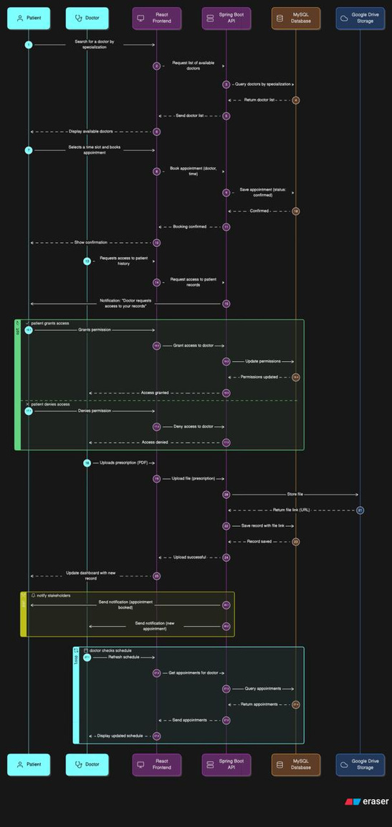
WorkFlow

Slide 8
THANK
YOU
Transforming healthcare through connected digital ecosystems

